Slide 1

MAJOR PROJECT (MCAN-482) PPT PRESENTATION ON CROP RECOMMENDATION SYSTEM SESSION: 2022-2024
PROJECT GUIDE:
MR. SOUMEN PRAKASH KABI
Assistant Professor (Dept. of CA)
Team Members:
Siddhartha Khawas (10871022006)
Subham Chakraborty (10871022007)
Sumit Kumar Choubey (10871022003)
Shivendu Shivam (10871022051)

Slide 2
ACKNOWLEDGEMENT
We would like to express our special thanks and gratitude to our guide MR. Souman Prakash Kabi, Asst. Professor Department of Computer Application. We would like to thanks our HOD sir Dr. Sujit Kumar Singh to provide us the opportunity to carry out the project. We would also like to thanks our honorable principal sir Dr. G.S. Panda who gave us the golden opportunity to do this wonderful project entitled “CROP RECOMMENDATION SYSTEM”, which also helped us in doing lots of research and we came to know about so many new things. We are really thankful to them.
We would also like to thank other faculty members of our Department, our parents and group members to complete the project within time.
Thank You all for your support.
SIDDHARTHA KHAWAS (10871022006)
SUBHAM CHAKRABORTY (10871022007)
SHIVENDU SHIVAM (10871022051)
SUMIT KUMAR CHOUBEY (10871022003)

Slide 3
DECLARATION
We hereby declare that the project entitled- “CROP RECOMMENDATION SYSTEM”, which is being submitted as Major Project of 5th semester in Master of Computer Applications (MCA) to Asansol Engineering College, Asansol (W.B) is the record of our genuine work under the guidance of our guide MR. SOUMEN PRAKASH KABI Department of Computer Application Asansol Engineering College, Asansol
SIDDHARTHA KHAWAS (10871022006)
SUBHAM CHAKRABORTY (10871022007)
SHIVENDU SHIVAM (10871022051)
SUMIT KUMAR CHOUBEY (10871022003)
Place:
Date:

Slide 4
Project Objective & Scope
Data Description
Methodology
Data Preprocessing
Models Used
Accuracy Comparison
GUI snapshot
Future Scope of Improvements
Contents

Slide 5
Project objective & scope
Objective:
To develop an intelligent crop recommendation system that uses machine learning to analyse soil nutrients (Nitrogen, Phosphorus, Potassium), environmental data (Temperature, Humidity, Rainfall), and soil pH to advise farmers on the most suitable crops to cultivate for optimal yield.
Goal:
Create a robust predictive model that inputs Nitrogen, Phosphorus, Potassium, Temperature, Humidity, pH, and Rainfall to generate accurate and personalized crop recommendations, thus increasing agricultural efficiency and sustainability.
Scope:
It is a useful project as the classifier models can be used to quickly determine the suitable crop for the cultiave in the soli of the large dataset.

Slide 6
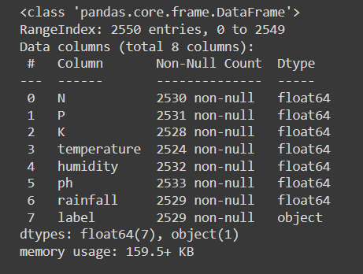
Data description
The description of the data with type and description of each Attribute is given/shown in the table.

Slide 7
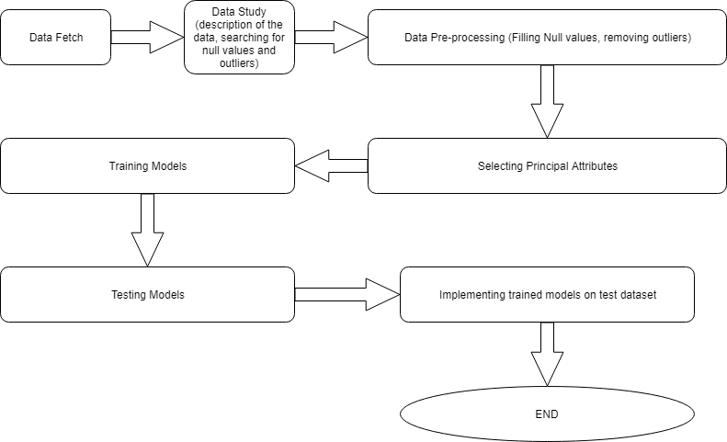
Methodology

Slide 8
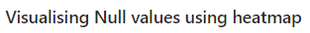
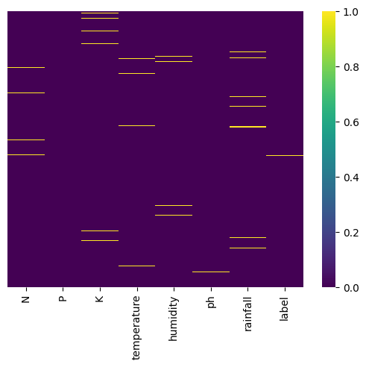
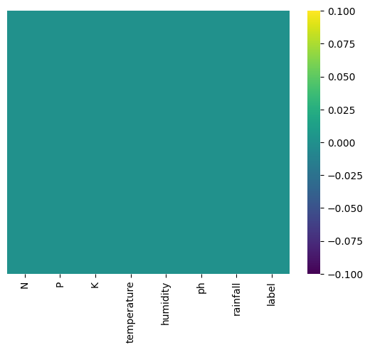
Data Preprocessing
Handling Null values
Before
After

Slide 9
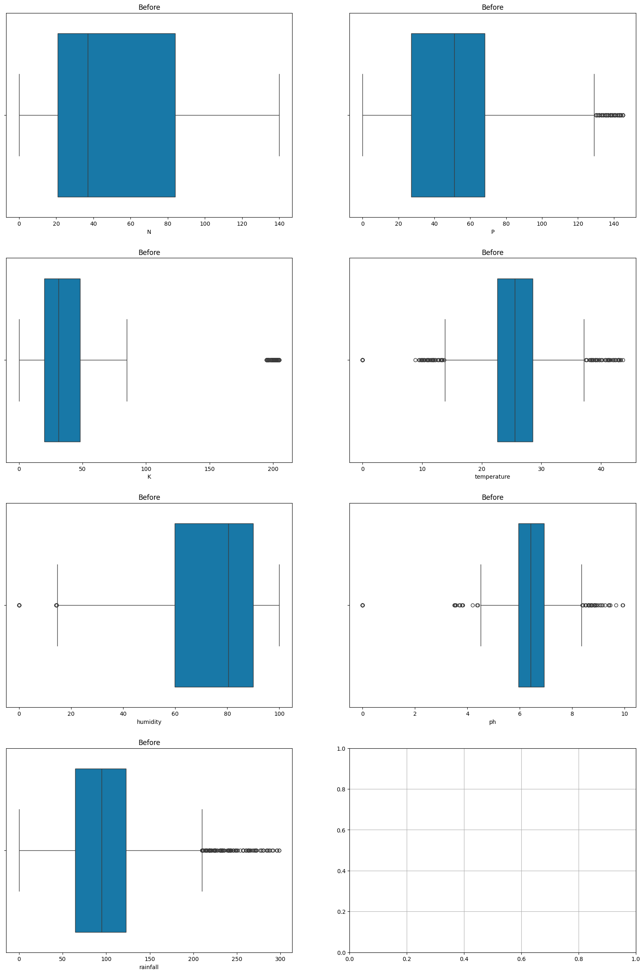
Outliers

Slide 10
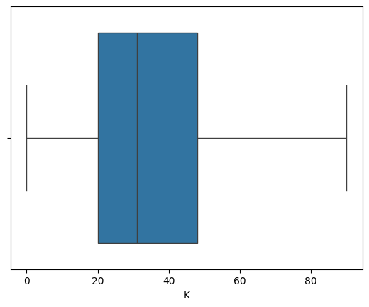
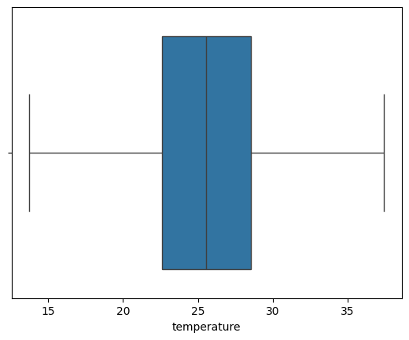
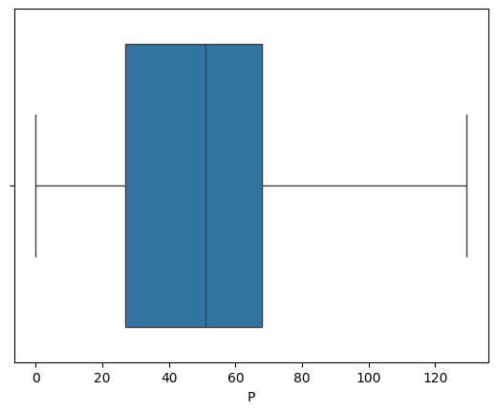
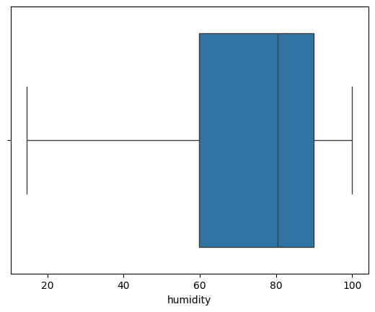
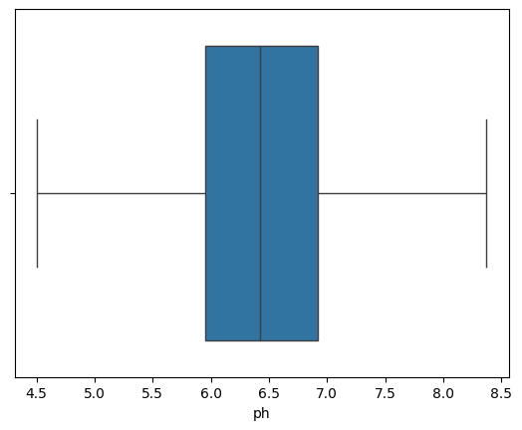
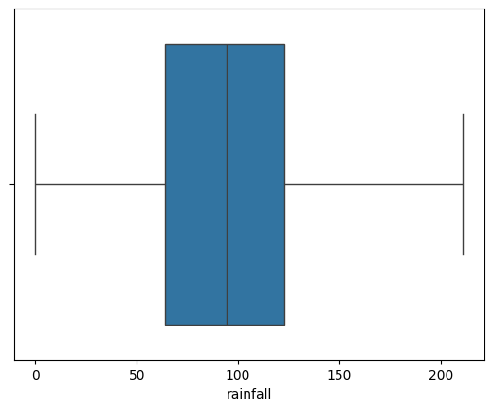
After removing the outliers

Slide 11
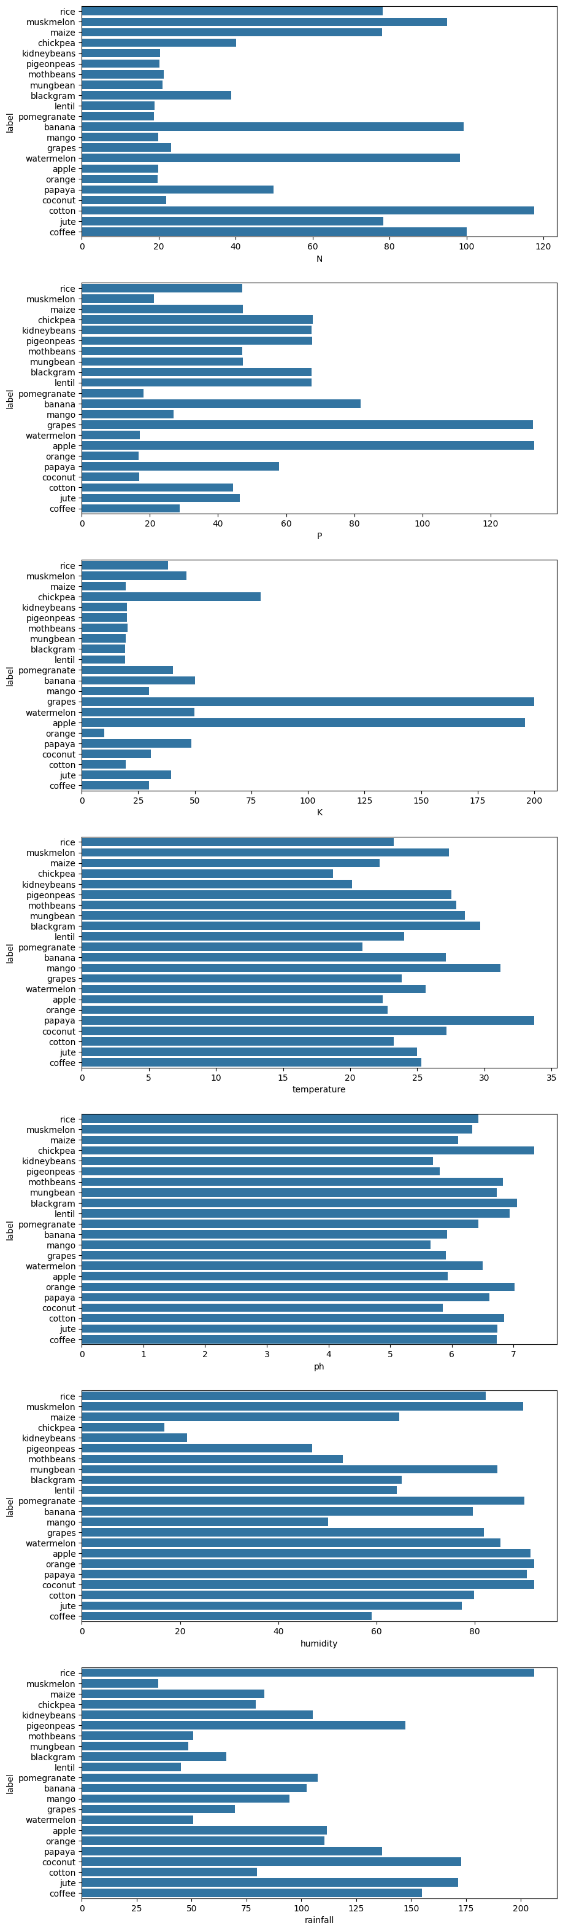
Visualising other attributes with respect to our target column i.e. 'Label'

Slide 14
GUI Version of Crop Recommendation System
(index page)

Slide 15
GUI Version of Crop Recommendation System (About us page)

Slide 16
GUI Version of Crop Recommendation System (Features page)

Slide 17
GUI Version of Crop Recommendation System (Contact page)

Slide 18
GUI Version of Crop Recommendation System (Details page)

Slide 19
GUI Version of Crop Recommendation System (Signup page)

Slide 20
GUI Version of Crop Recommendation System (Login page)

Slide 21
GUI Version of Crop Recommendation System (Main page)

Slide 22
GUI Version of Crop Recommendation System (Main page)

Slide 23
GUI Version of Crop Recommendation System (Main page with result popup)

Slide 24
GUI Version of Crop Recommendation System (forgot your password page)

Slide 25
GUI Version of Crop Recommendation System (forgot password reset request mail send in your registered email id )

Slide 26
GUI Version of Crop Recommendation System (Reset page of your password )

Slide 27
Models used
The Machine Learning models used for this project are:
Decision Tree
Logistic Regression
Random Forest
SVM Classifier

Slide 28
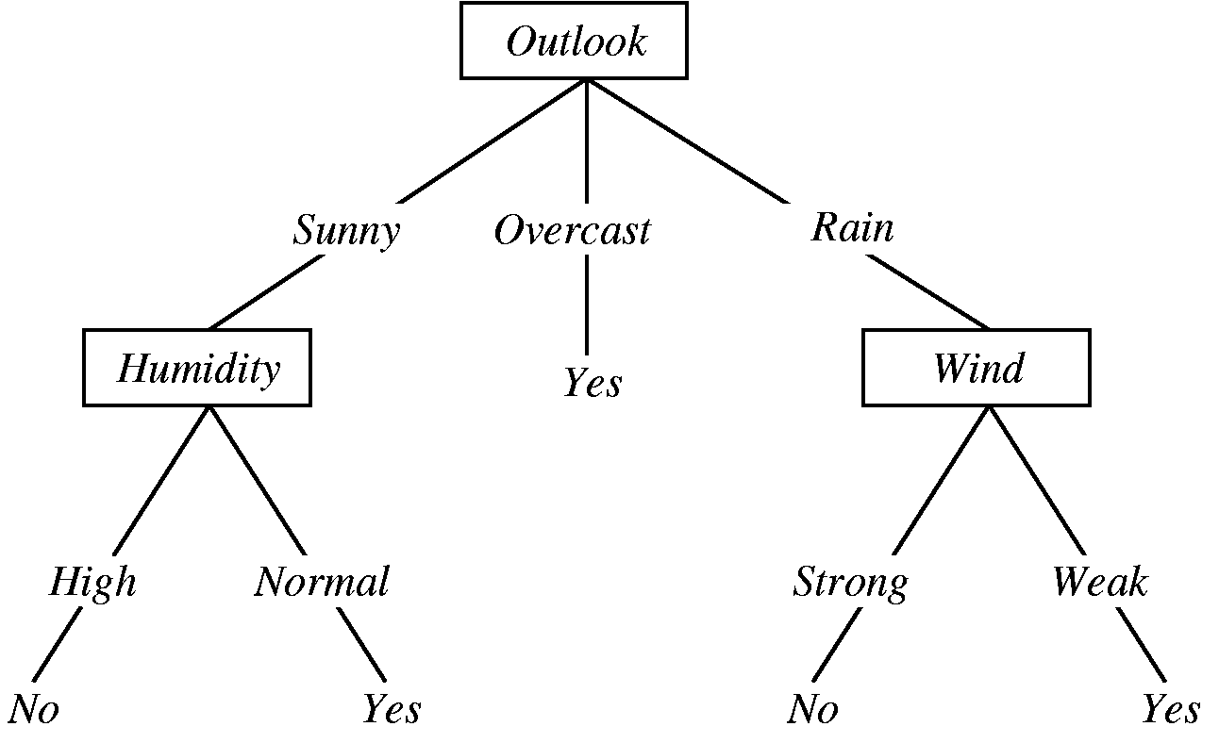
Decision tree
A decision tree is a graphical representation of specific decision situations that are used when complex branching occurs in a structured decision process. A decision tree is a predictive model based on a branching series of Boolean tests that use specific facts to make more generalized conclusions.
The main components of a decision tree involve decision points represented by nodes, actions and specific choices from a decision point. Each rule within a decision tree is represented by tracing a series of paths from root to node to the next node and so on until an action is reached.

Slide 29
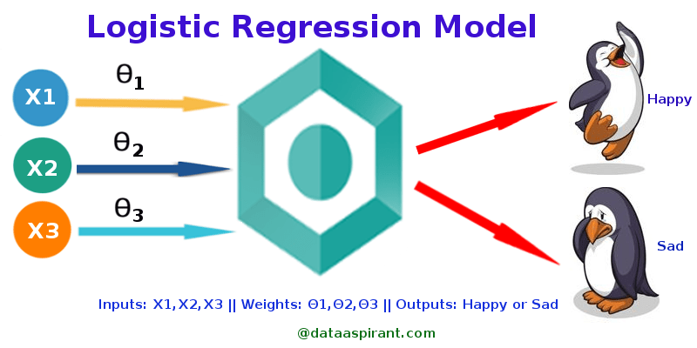
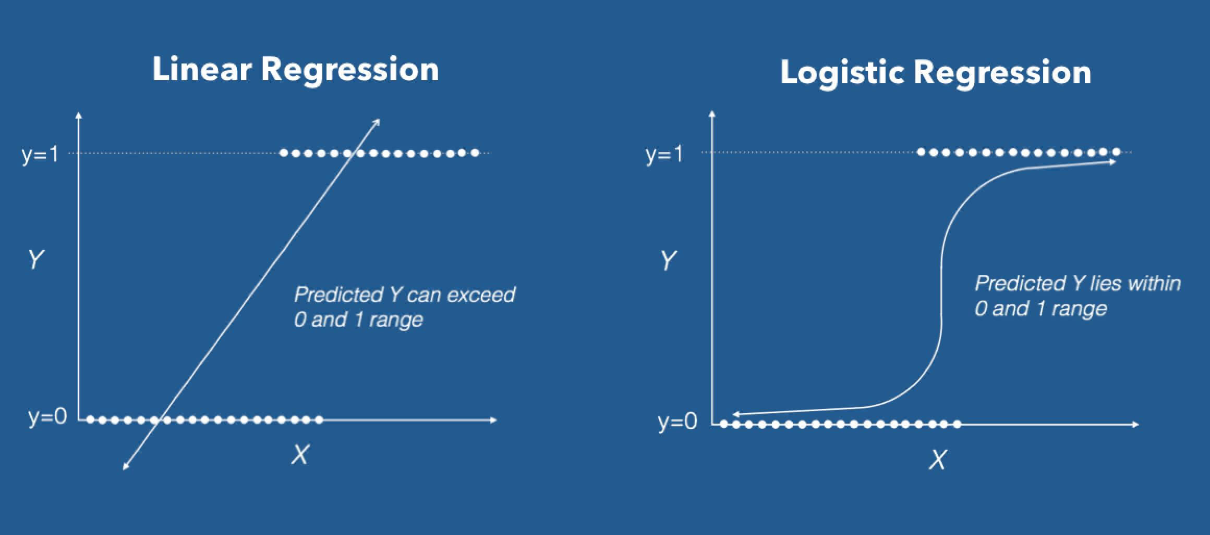
Logistic regression
Logistic Regression is the appropriate regression analysis to conduct when the dependent variable is dichotomous (binary). Like all regression analyses, the logistic regression is a predictive analysis. Logistic regression is used to describe data and to explain the relationship between one dependent binary variable and one or more nominal, ordinal, interval or ratio level independent variables.

Slide 30
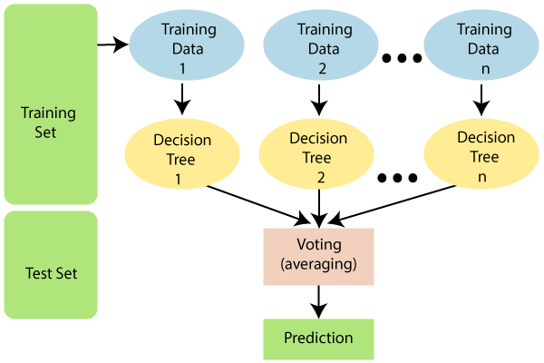
Random Forest
Random Forest is a classifier that contains a number of decision trees on various subsets of the given dataset and takes the average to improve the predictive accuracy of that dataset. Instead of relying on one decision tree, the random forest takes the prediction from each tree and based on the majority votes of predictions, and it predicts the final output.
The greater number of trees in the forest leads to higher accuracy and prevents the problem of overfitting.

Slide 31

Support Vector Machine Algorithm (SVM)
Support Vector Machine or SVM is one of the most popular Supervised Learning algorithms, which is used for Classification as well as Regression problems. However, primarily, it is used for Classification problems in Machine Learning.
The goal of the SVM algorithm is to create the best line or decision boundary that can segregate n-dimensional space into classes so that we can easily put the new data point in the correct category in the future. This best decision boundary is called a hyperplane.

Slide 32
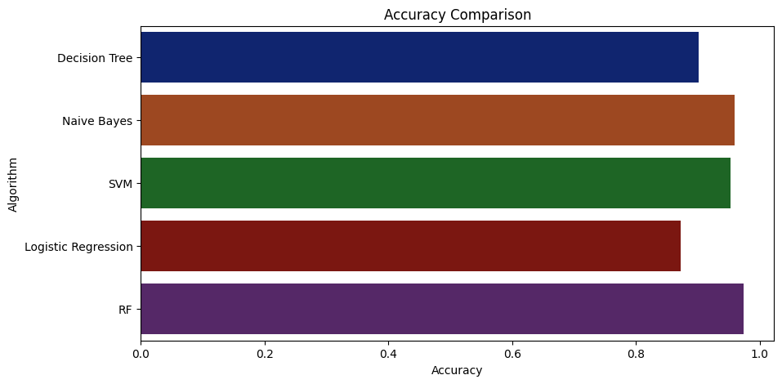
Accuracy comparison graph
Models | Accuracy %
Decision Tree | 90%
Logistic Regression | 88%
NB Classifier | 97%
Random Forest | 98%
SVM Classifier | 96 %
The data shown above is an average of multiple test runs.
We see that the highest accuracy for the train dataset is Random Forest.
So we select Random Forest model to predict the test dataset.

Slide 33
Future advancements in crop recommendation systems could involve integrating real-time data from IoT devices and satellite imagery, enhancing predictive algorithms with deep learning techniques, and personalizing recommendations based on individual farmer preferences.
Improvements in user interface design and accessibility, along with the integration of multi-criteria decision-making methods, could further enhance the usability and effectiveness of these systems.
Collaborative platforms for knowledge sharing among farmers and experts, along with extensive field testing and validation, are essential for ensuring the scalability, reliability, and impact of crop recommendation systems in diverse agricultural settings.
By addressing these areas of improvement, crop recommendation systems can better support farmers in making informed decisions, optimizing resource use, and increasing agricultural productivity
Future scope of
improvements

Slide 34
Thank you
Asansol Engineering College
Siddhartha Khawas (khawassiddhartha73@gmail.com)
Subham Chakraborty (csubham981@gmail.com)
Sumit Kumar Choubey (montuking88@gmail.com)
Shivendu Shivam (shivamlkr502@gmail.com)

